Slide 1

AUTOMATIC BLINDS CONTROL SYSTEM
Osama Naji Amr
Emir Ayar
Çağla Kutluk Baydemir
November - 2024

Slide 2
Contents
Goal of the Project
Electronic Analysis
Mechanical Analysis
MATLAB Results

Slide 3
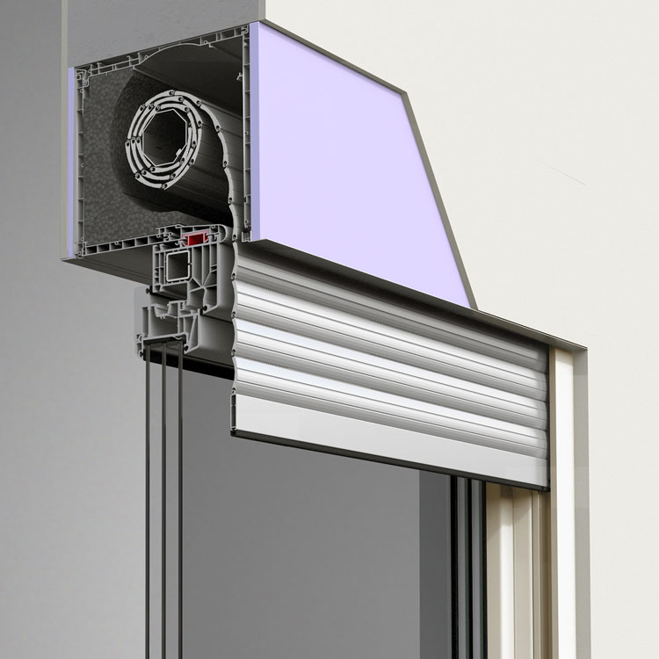
Key Goals of the Project
The aim is to develop a model of an automated blinds system using a DC motor and implement a PID control scheme. The project will also analyze performance under various conditions.

Slide 4
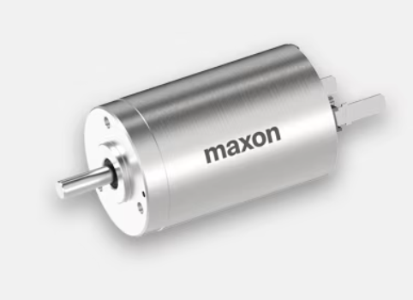
DCX 22 S MODEL
The Maxon DCX 22 S motor is an ideal choice for the automated blinds project because :
it combines compact size, high precision, and efficient performance.
Its ironless winding design allows smooth, continuous motion—important for stable blind operation.
With a torque constant (Kt) of 0.019 Nm/A and a back EMF constant (Ke) of 0.019 V/(rad/s), it works well with the control system requirements in our simulation.
The DCX 22 S's low inertia also enables quick acceleration and deceleration. (very useful in systems like this blinds’ system)

Slide 5
System Components
This table summarizes key mechanical and electrical parameters crucial for the functionality of the automatic blinds control system.
PARAMETER | VALUE | UNIT
Mass of Blinds | 2.0 | kg
Radius | 0.05 | m
Moment of Inertia | 0.01 | kg·m²
Friction Torque | 0.05 | Nm
Motor Resistance | 1.1 | Ω
Motor Inductance | 0.015 | H

Slide 6
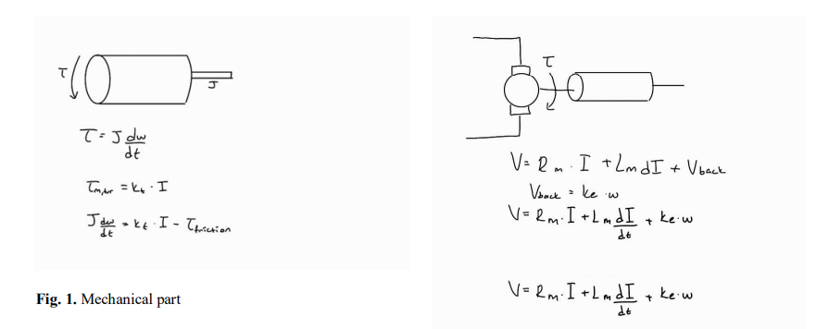
Modeling Dynamics
Electrical Dynamics
The system’s electrical dynamics are captured by a differential equation integrating voltage, resistance, and back EMF, defining current change over time.
(Ke): Back EMF constant
(Rm): Motor resistance
(Lm): Motor inductance
(V): Voltage
(I): Motor current

Slide 7
Modeling Dynamics
Mechanical Dynamics
Mechanical dynamics are described with a second differential equation that relates motor torque and friction to angular acceleration of the blinds.
(m): Mass of blinds
(R): Radius of blinds
(J): Moment of inertia
(τ friction): Friction torque
(Kt): Torque constant
(I): Motor current
(ω): Angular velocity of blinds

Slide 8
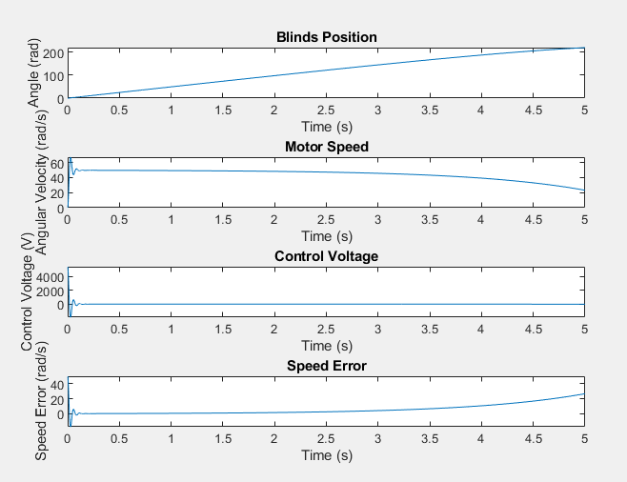
Simulation Results

Slide 9
Simulation Results
Blind Position
Approaching target speed
Stable operation (PID Voltage)
Speed Error
Initial motor speed ramps up quickly as the blinds begin to close.
Speed oscillates as it stabilizes near the setpoint. (50rad/s)
Motor speed remains consistent with minor fluctuations.
Speed error is detected when the motor speed starts drifting away from desired speed. (50rad/s).
Decreased speed due to increased load as blinds fully close.

Slide 10
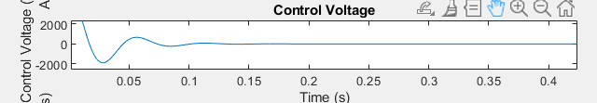
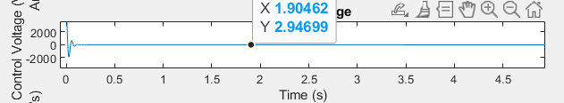
PID Control Overview
As shown, an oscillation spike can be seen at the intial voltage due to the PID controller taking some time to start its “controlling effect”. A steady voltage and current are kept to maintain the desired motor speed.(50rad/s).
It may look like the steady voltage is 0 but it is not. A 0V would cause no current through the motor and thus, the motor will stop moving and the blind will not close. A very small voltage value is reasonable though.

Slide 11
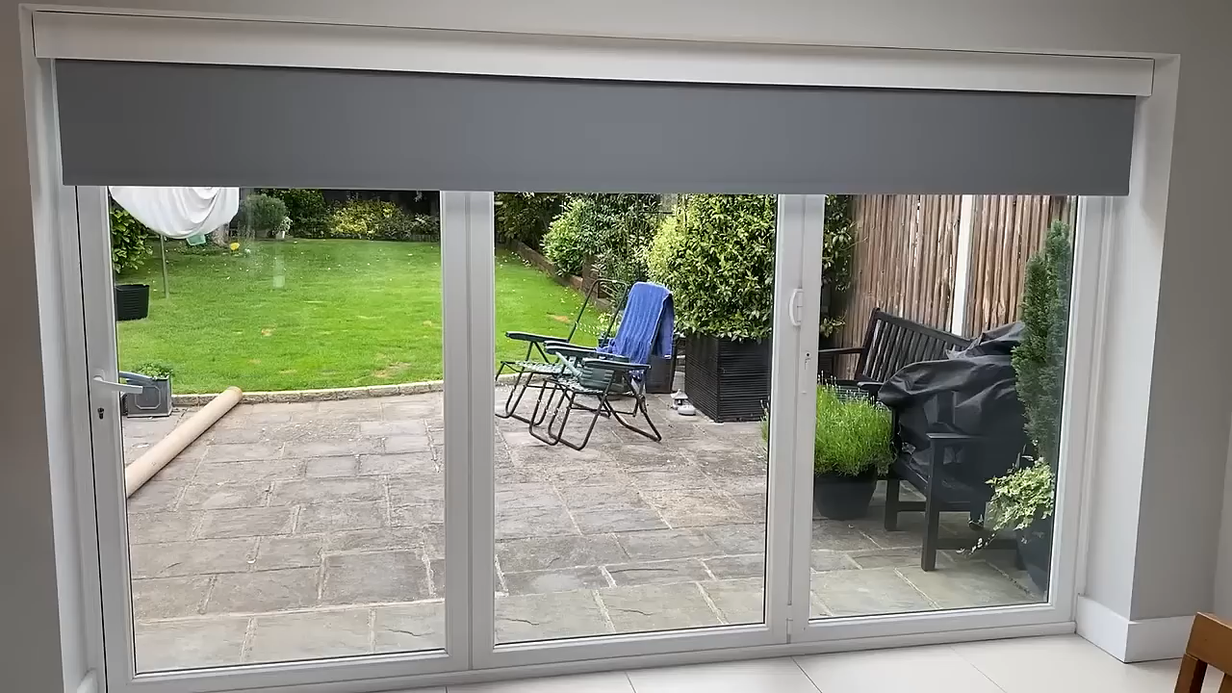
Conclusion & Future Work
Summary and Applications
The automatic blinds control system successfully integrates PID control for efficiency. Future enhancements may include smart features for improved adaptability.

Slide 12
Questions?

Slide 13
Thank you for listening

